Slide 1


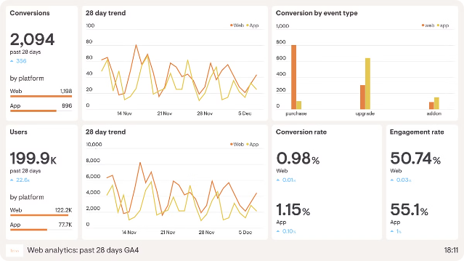
Data Analysis of an Ecommerce Website
This presentation explores the data analysis of an ecommerce website, with a focus on reducing order cancellations. The insights and solutions provided aim to optimize the website's performance and enhance the customer experience.
Parth Sharma
B.Tech 3rd year
AIML

Slide 2

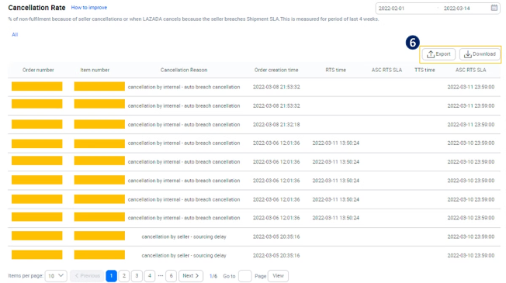
Insight 1: Cancellation Trends
1
Order Cancellation Rates
The data reveals that order cancellation rates vary across different states and union territories. Understanding these regional differences is crucial for targeted solutions.
2
Top Cancellation States
Tamil Nadu stands out as the 7th largest population and the 3rd most cancellation-prone state, indicating a need for focused attention.
3
Cancellation Breakdown
Further analysis shows that 70% of cancellations are from cash-on-delivery (COD) orders, suggesting opportunities to address this specific payment method.

Slide 3

Insight 2: Cancellation Drivers
Premanifest Cancellations
Cancellation Reasons
The data indicates that approximately 80% of cancellations in Tamil Nadu occur before the order is manifested, highlighting the need to address this specific issue.
Understanding the underlying reasons for cancellations, such as product availability, delivery timelines, or customer preferences, can help develop targeted solutions.

Slide 4
Solution 1: Reducing Premanifest Cancellations
Targeted Interventions
Personalized Outreach
Streamlined Processes
Implement strategies to address the high premanifest cancellation rate in Tamil Nadu, such as improving product availability, enhancing delivery timelines, and optimizing the customer experience.
Utilize customer data and analytics to identify high-risk cancellation segments and proactively engage with them through personalized communication and offers.
Review and optimize the order fulfillment process to minimize delays and ensure a seamless customer journey, reducing the likelihood of premanifest cancellations.

Slide 5
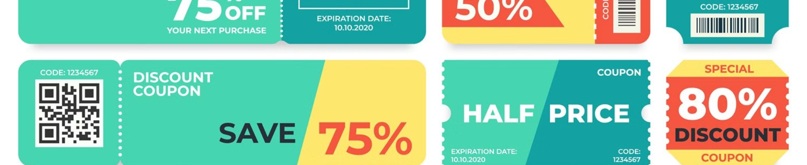


Solution 2: Incentivizing Prepaid Orders
Discount Coupons
Additional Offers
Offer 20% discount coupons on prepaid order options to incentivize customers and reduce the reliance on cash-on-delivery, which accounts for 7% of cancellations.
Introduce other promotional offers and discounts on popular items to further encourage customers to choose prepaid options, improving overall order fulfillment and reducing cancellations.

Slide 6


Enhancing the Customer Experience
1
Improved Product Availability
Ensure a robust inventory management system to maintain optimal product availability, addressing a key driver of order cancellations.
2
Reliable Delivery Timelines
Optimize the logistics and transportation network to provide accurate and reliable delivery timelines, setting appropriate customer expectations.
3
Personalized Recommendations
Leverage customer data and analytics to offer personalized product recommendations, enhancing the overall shopping experience and reducing the likelihood of cancellations.

Slide 7


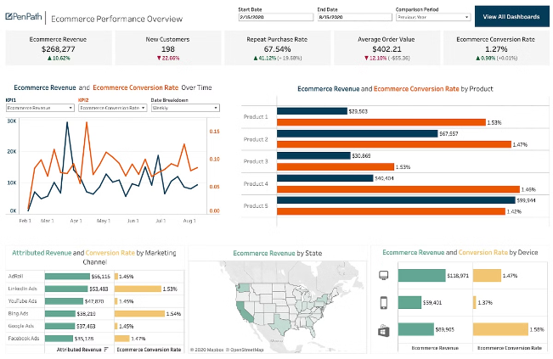


Monitoring and Continuous Improvement
Data-Driven Insights
Continuously monitor and analyze order cancellation data to identify emerging trends and refine the strategies implemented.
Iterative Optimization
Regularly review and optimize the solutions based on customer feedback and performance metrics, ensuring ongoing improvements in reducing order cancellations.
Cross-Functional Collaboration
Foster collaboration across different teams, such as marketing, operations, and customer service, to align on a holistic approach to address order cancellations.

Slide 8


Conclusion
Targeted Interventions
Personalized Outreach
Streamlined Processes
Discount Coupons
Additional Offers
Improved Customer Experience
By implementing a comprehensive strategy that addresses the key drivers of order cancellations, the ecommerce website can enhance customer satisfaction, improve operational efficiency, and drive long-term business growth.

